Slide 1
Basic SparkSQL operations

Slide 2
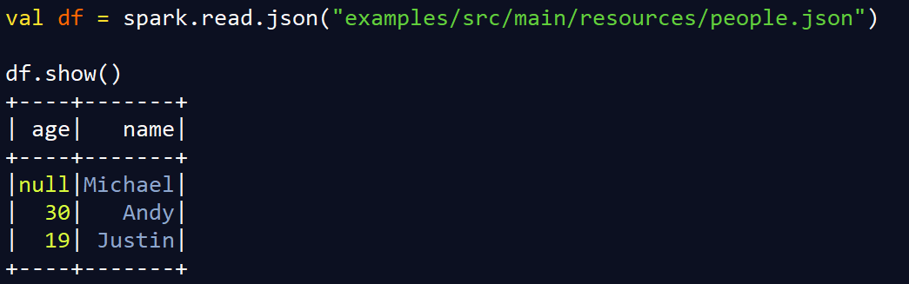
Creating Data Frames
Assume the people.json has the following information:
{"name":"Michael"}
{"name":"Andy", "age":30}
{"name":"Justin", "age":19}
The code above reads a json into a dataframe. Spark is able to automatically infer the schema of the json by sampling the data.
The show function is use to display the contents of the dataframe.

Slide 3
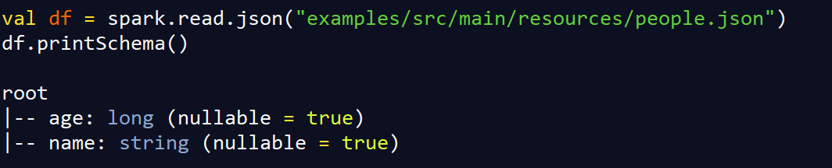
Print Schema
Assume the people.json has the following information:
{"name":"Michael"}
{"name":"Andy", "age":30}
{"name":"Justin", "age":19}
The code above prints out the schema that spark has inferred for the json file.

Slide 4
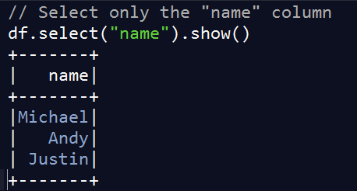
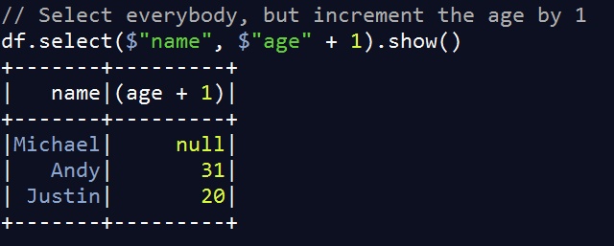
Select
Assume the people.json has the following information:
{"name":"Michael"}
{"name":"Andy", "age":30}
{"name":"Justin", "age":19}

Slide 5
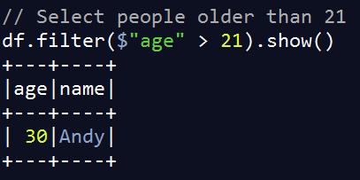
Filter
Assume the people.json has the following information:
{"name":"Michael"}
{"name":"Andy", "age":30}
{"name":"Justin", "age":19}

Slide 6
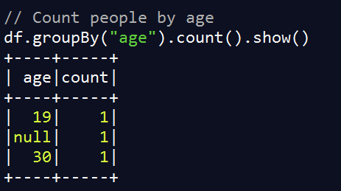
groupBy
Assume the people.json has the following information:
{"name":"Michael"}
{"name":"Andy", "age":30}
{"name":"Justin", "age":19}

Slide 7
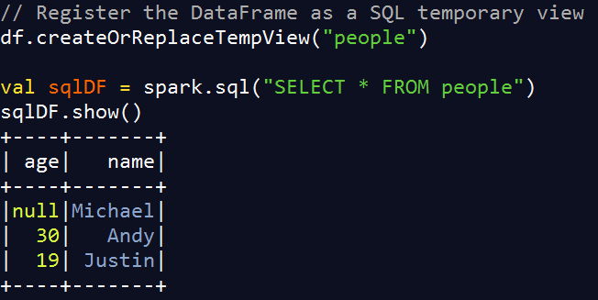
Running SQL Queries Programmatically
Assume the people.json has the following information:
{"name":"Michael"}
{"name":"Andy", "age":30}
{"name":"Justin", "age":19}

Slide 8
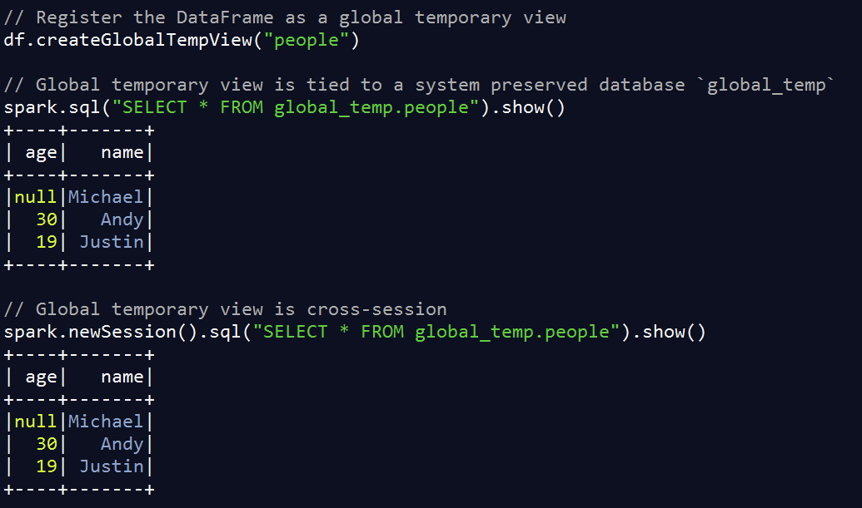
Global Temporary View
Temporary views such as that shown in the previous slide will only exist during the session.
Global temporal views can be used to keep dataframes across sessions.
Like in Hive, when you end a session, the table still stays in the database.

Slide 9
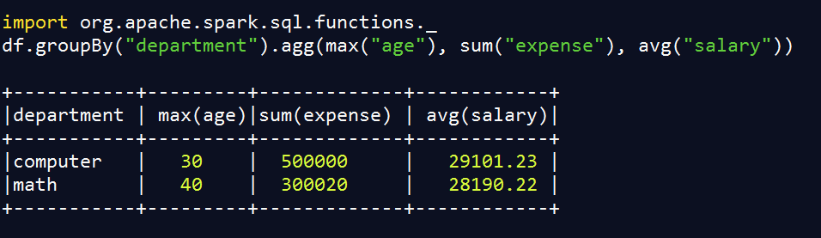
Aggregation
Inside the RelationalGroupedDataset class there is a function method called agg that can be used to return different types of aggregations.
The above example shows how to compute multiple types of aggregation for each group.
In the above case, we first group by “department”. For each department we compute the maximum age, the total expenses and the average salary.
For more API calls for the RelationalGroupedDataset class see the link below:
https://spark.apache.org/docs/2.0.1/api/java/org/apache/spark/sql/RelationalGroupedDataset.html

Slide 10
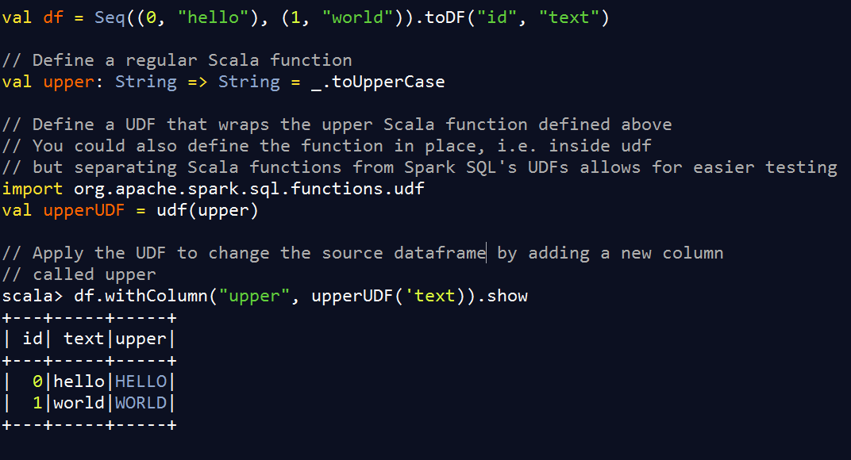
User Defined Functions and Adding new Columns
Often when you write code you want to call a customized function.
In the example below we want to add a new column which has the text in upper case

Slide 11
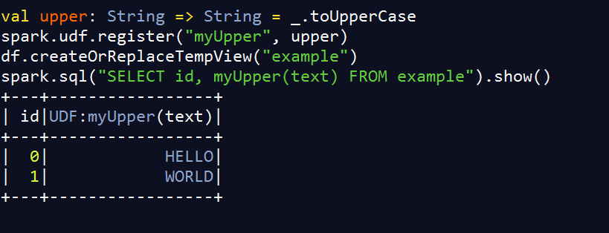
UDF Registration
You can register UDFs to use in SQL-based query expressions via UDFRegistration

